Slide 1


Meeting Room Pro
Website: https://navsingh.org.uk/mrpro
Navjot Singh Virk
24/August/2017
Available On:
Github/Virksaabnavjot/MRPRO

Slide 2
Introduction
MeetingRoom Pro (Find, Review, Book)
What is the project/product about ?
Project Context
A room assistant application that allows the user to
Book Rooms
Navigate
See the Building and the Meeting room on the map
Look at room gallery and upload images and review rooms .
And more discussed in further slides.

Slide 3
Background
What were the reasons to choose this project?
Its very hard to find rooms in large corporate buildings.
Is very hard to find rooms/location in a building if you are new to the environment.
The idea originated during my internship, when it was hard to find and book meeting rooms.
People needed easy solution to book and find rooms.
People needed an organized system, where they can choose b/w rooms based on their

Slide 4
Project Goals
Build easy and user friendly GUI.
Build easy to use features and functionality.
Minimal learning curve to start using the application to its fullest.
Expand internationally.
Happy users and Customer.

Slide 5
Target Users
Who can use this product ?
Corporate companies and their employees.
Schools, Colleges and Universities
Teachers and Students
Facilities department
IT department

Slide 6








List of Features Users can benefit from ?
SEARCH
LIST AND FIND
MAP AND ROOM
DETAILS
REVIEWS
GALLERY
PHOTO UPLOAD
BOOK ROOM
MY MEETINGS

Slide 7
Competitors
Room Finder
Allows to find and book rooms inside Outlook and Office 365.
Drawbacks: Limited to outlook / microsoft products, plugin and not an independent application.
Skedda
Online booking and scheduling for meeting rooms.
Drawbacks: Only available to publically available places and only web based.

Slide 8






System (iOS Application)
What are the technologies used ?
Front-end : iOS Application is built with Swift 3 using Xcode IDE.
XCODE
SWIFT 3
JSON
MAPKIT
COCOAPODS
CORE LOCATION

Slide 9





System (WEB Service)
What are the technologies used ?
Back-end : Web service using PHP, CodeIgniter, webhost using Apache server and MySQL database.
PHP
CodeIgniter
JSON
MySQL
000 Web host
phpMyAdmin

Slide 10
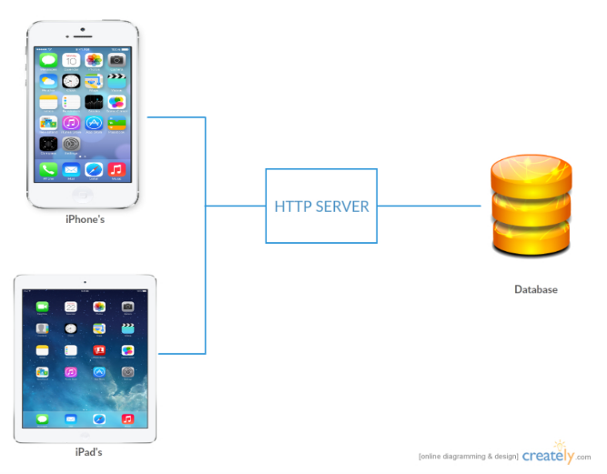
System
System Architecture

Slide 11
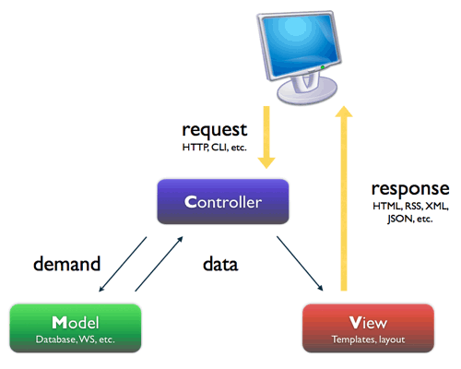
System
MVC Architecture (CodeIgniter)

Slide 12
System
Main algorithms
Room Booking
Parsing JSON
Parsing Geo-spatial data
Gallery and Image Upload
Review System
Room Search

Slide 13
Design
Overview of the main functional requirements/features.
Easy to Use GUI
List and Find (Search)
Map / Navigation
My Meetings
Booking System
Review
Gallery and Photo Upload

Slide 14
App Features Summary and Demonstration
FEATURE 1: SEARCH
Search Buildings
And
Meeting Rooms

Slide 16
App Features Summary and Demonstration
FEATURE 2: LIST AND FIND
View List of available Buildings
and rooms available in them
with relevant hints and information

Slide 18
App Features Summary and Demonstration
FEATURE 3: MAP AND ROOM DETAILS
Allows the user to see the building and room on the map, user can opt between 2d or 3d view of the map to see the actual building and places around it and all the related information to the room.

Slide 20
App Features Summary and Demonstration
FEATURE 4: GALLERY
Allows the user to see pictures of the room, which helps him to make decisions based on his/her requirements.

Slide 22
App Features Summary and Demonstration
FEATURE 5: PHOTO UPLOAD
Allows the user to add/upload
Pictures of the rooms and building to the cloud from the camera or phone’s gallery.

Slide 24
App Features Summary and Demonstration
FEATURE 6: USER REVIEWS
Allows the user to review and provide the rating for a room based on their experience with the room, this feature helps other users and admin to get more insights about the room.

Slide 26
App Features Summary and Demonstration
FEATURE 7: ROOM BOOKING
Allows the user to book meeting room by choosing a room, title, date and time
And the people he wants to invite to the meeting.

Slide 28
App Features Summary and Demonstration
FEATURE 8: MY MEETINGS
Allows the user to view all
the booked meetings/rooms.

Slide 30
Discussions
Advantages ?
The application is easy to use and very useful.
Disadvantages and Limits ?
Huge Data requirements.
Opportunities ?
International expansion as the application is very scalable.
Future Perspectives?
Indoor Navigation, using beacons or wifi - triangulation.

Slide 31
Main Requirements
System
Client – iOS 10+ iOS Devices
Internet Connection, GPS
Backend – MySQL database version with Geospatial data support.

Slide 32
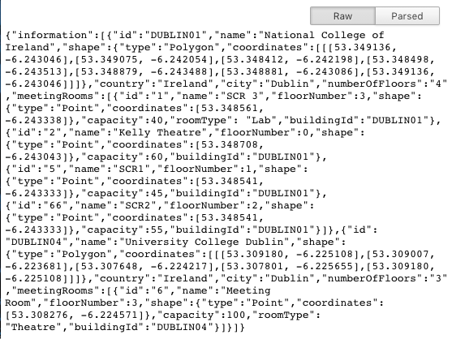
Main Requirements
Data
Building and Room information including co-ordinates (Geo Spatial Data – Polygons & Points or saved as String and parse on frontend.)

Slide 33
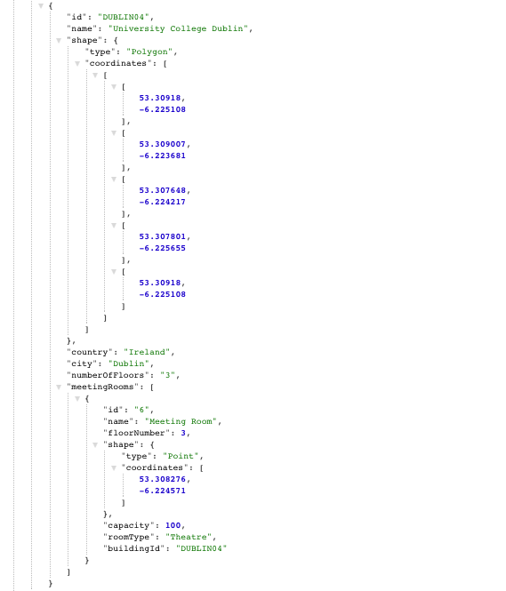
Parsed JSON Data Sample
returned by the Web Service
through http request,
Similar data is
consumed by the client
Application.

Slide 34
Evaluation
How will you evaluate the system?
Unit Testing and User Testing and Heuristic Evaluation is incorporated in the project for evaluation.
What is Unit Testing ?
Unit Testing is a testing by which individual units of code are tested to determine whether they fit for use.
What is User Testing ?
User testing is the most effective way to discover any barriers that users will face.
What is Heuristic Evaluation ?
Usability inspection method for computer software.

Slide 35
Unit Testing

Slide 36
User Testing (Survey)

Slide 37
Heuristic Evaluation

Slide 38
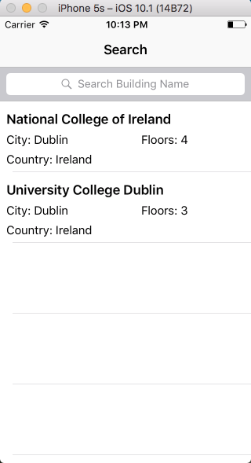
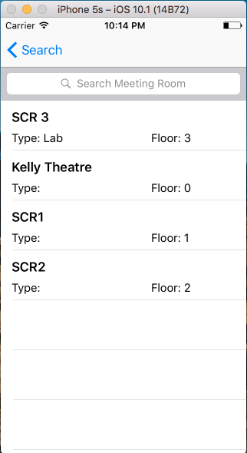
Demonstration
GUI (Screen Shots)
List of
Buildings
List of
Meeting
Rooms

Slide 39
Demonstration
DEMO OF THE APPLICATION ON REAL DEVICE.

Slide 40
Discussion
General Discussion
Questions
Feedback

Slide 41
The End
Thanks

